Slide 1
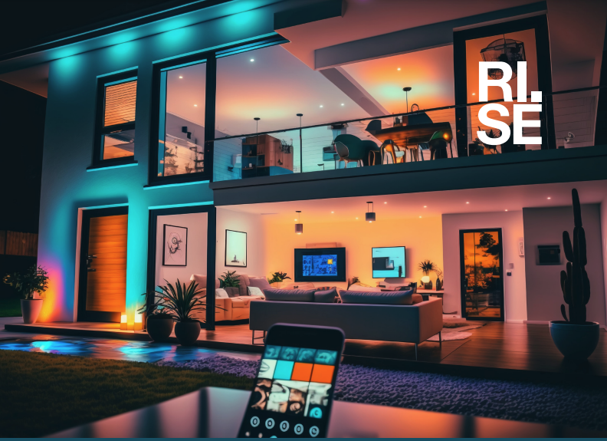

Edge AI in Action: Empowering Smart Devices & Connected Physical Products Joakim Eriksson RISE Research Institutes of Sweden Computer Science Department Guest Lecture November 11, 2025
joakim.eriksson@ri.se

Slide 2
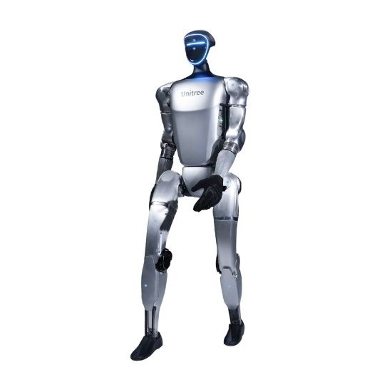
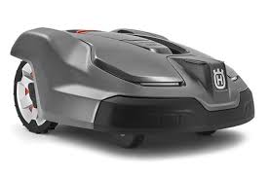

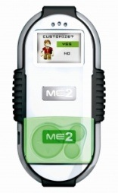
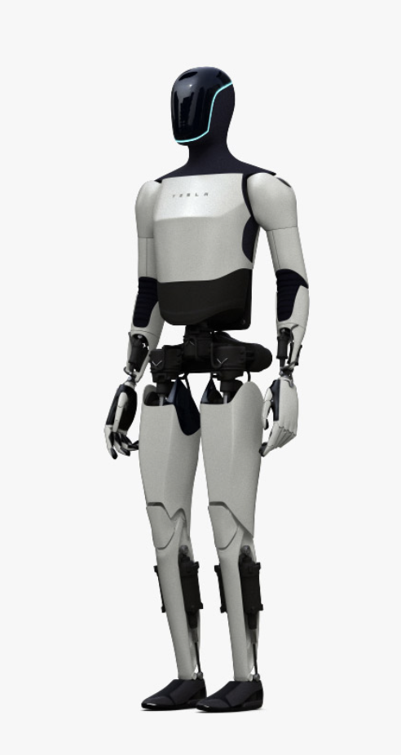
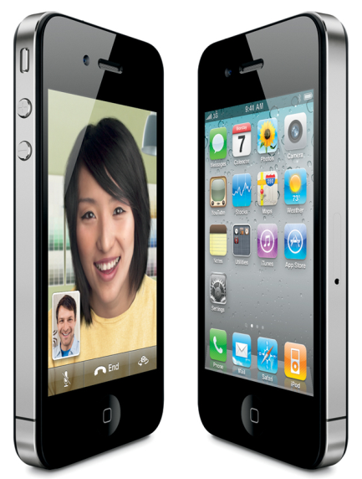
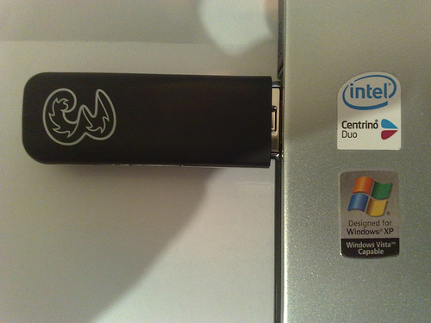
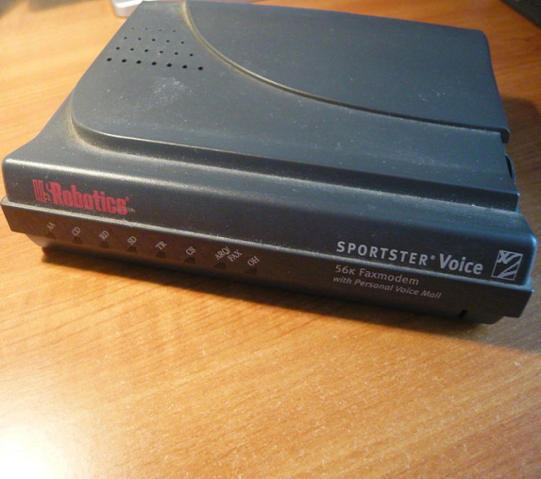
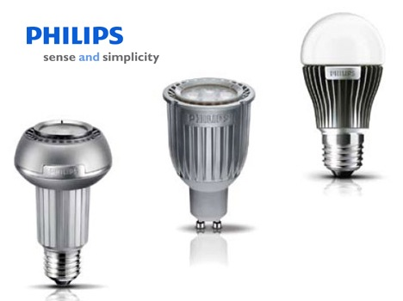
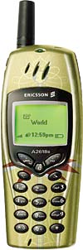
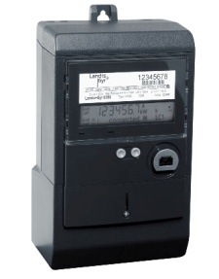
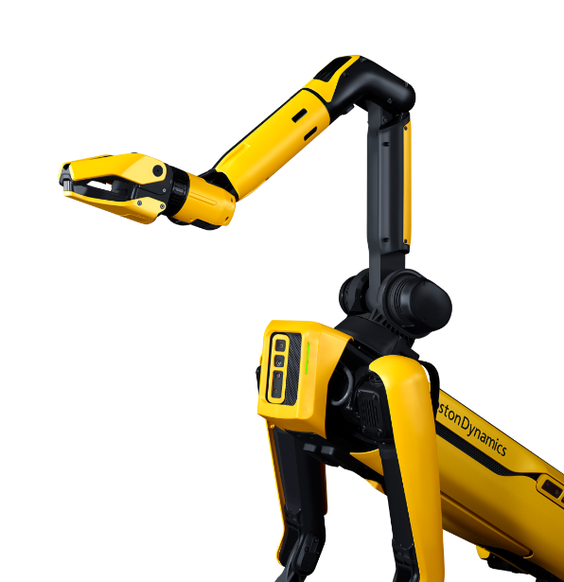
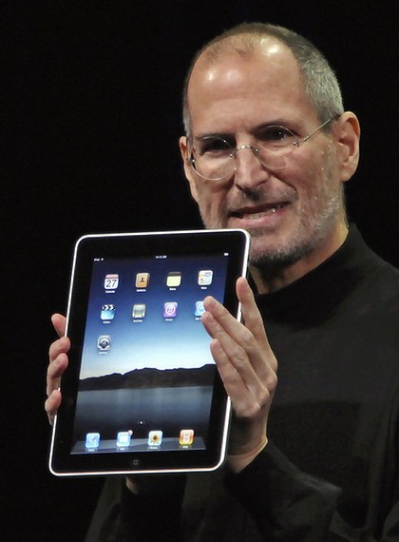
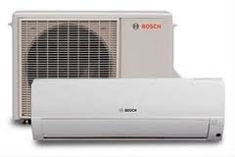
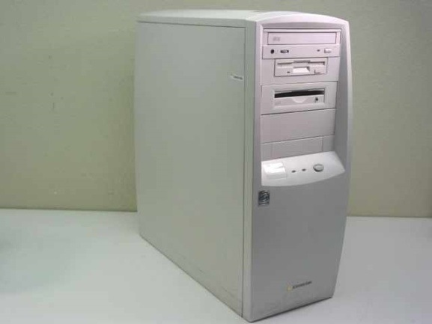
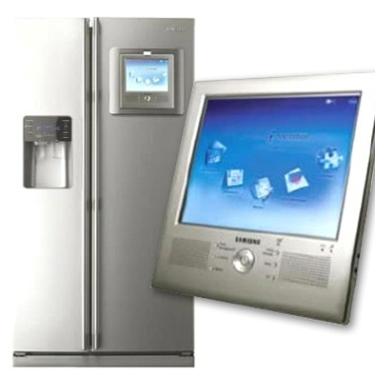
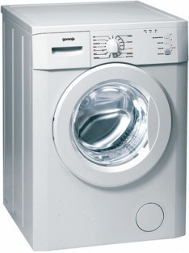
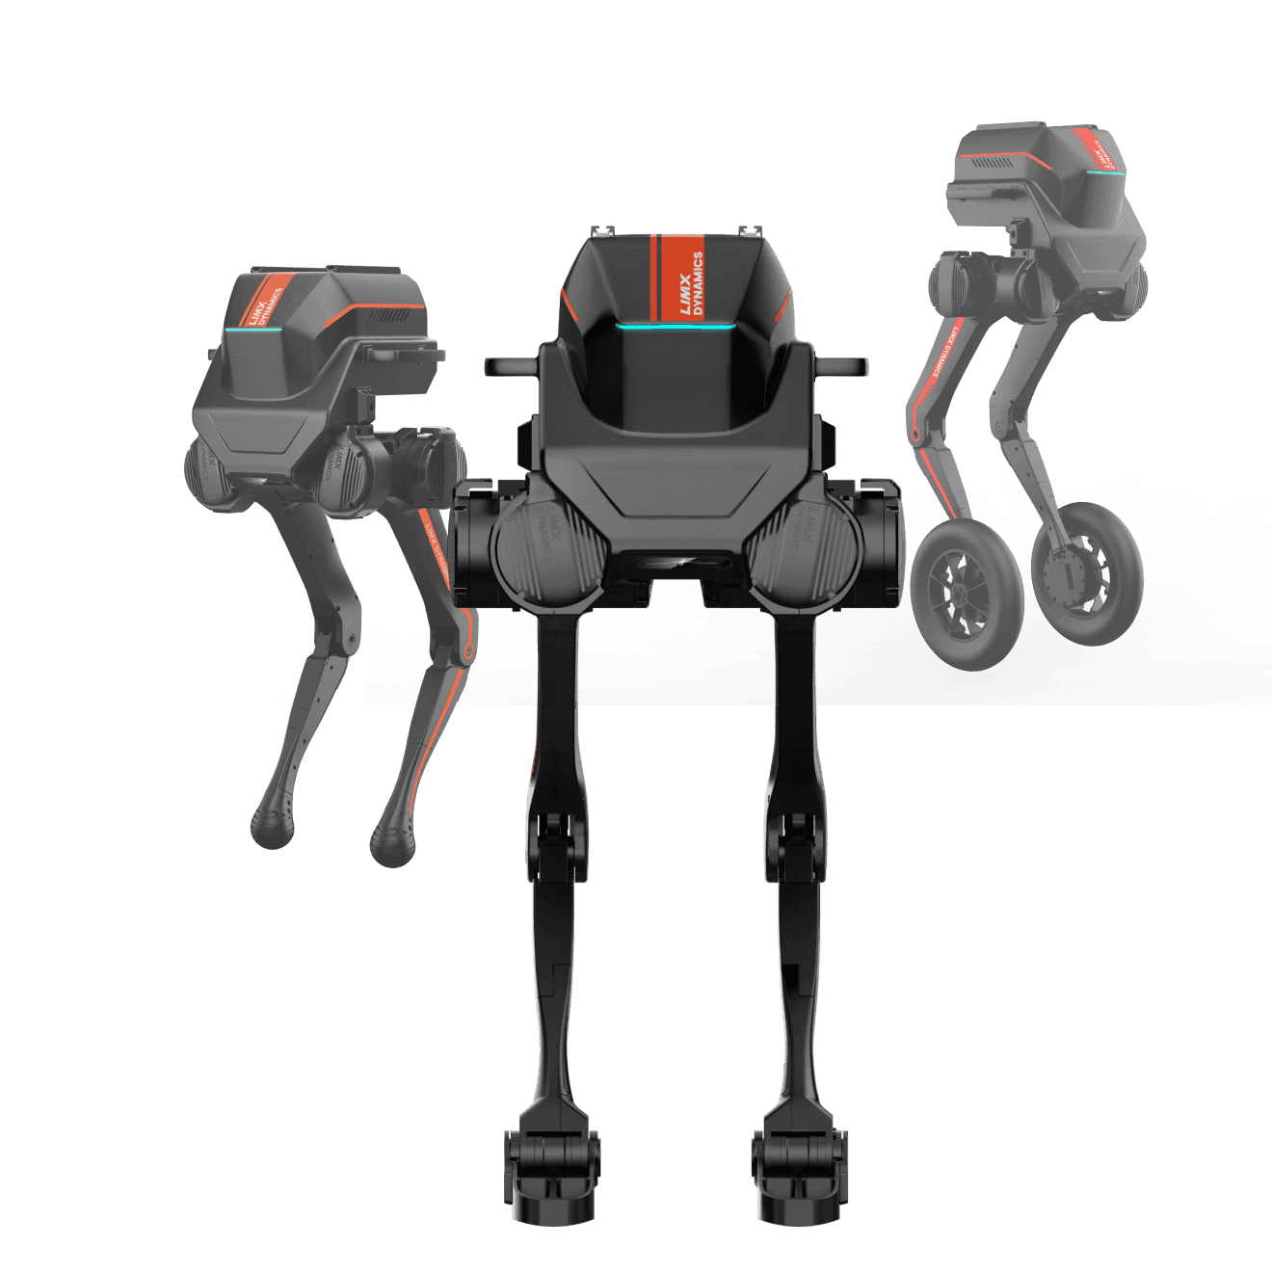
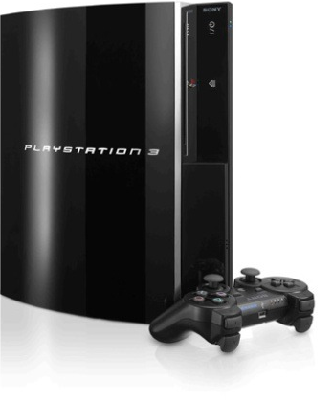
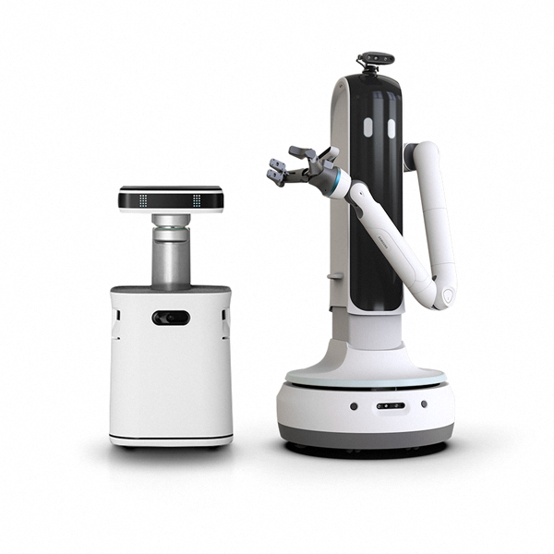
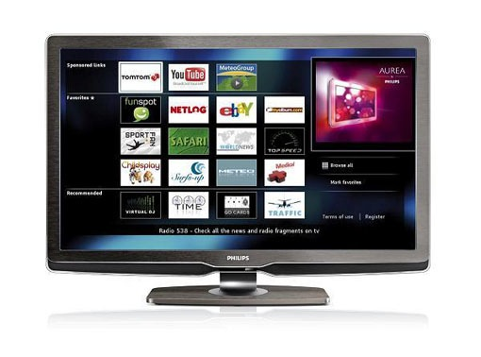
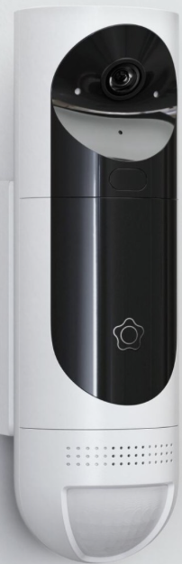
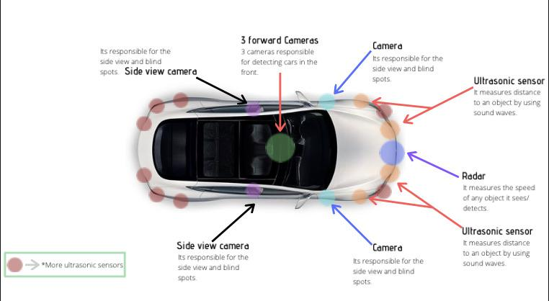
Internet of Things / Connected Products
2010
2020
>2025…
2000
PC
Media
Robotics
Embedded
Notes:
2000s – The Internet of People:
“In the early 2000s, connectivity was mostly about people — desktops and dial-up modems, basic phones — all focused on human users.”
• 2010 – The Media Explosion:
“A decade later, we saw the rise of smartphones, smart TVs, and gaming consoles — media became mobile and more interactive, laying the groundwork for ‘smart’ environments.”
• 2020 – Embedded Intelligence:
“By 2020, intelligence moved into everyday appliances — smart lighting, washing machines, HVAC, cameras. Devices weren’t just connected — they were starting to understand.”
• >2025 – The Age of Edge Intelligence & Autonomy:
“Today and looking forward, AI is entering the physical world through robotics, autonomous systems, and smart assistants. These systems sense, reason, and act at the edge, powered by embedded AI.”

Slide 3
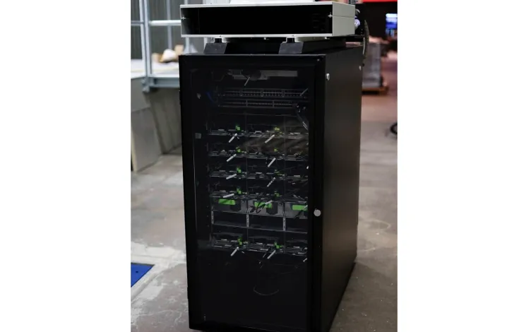
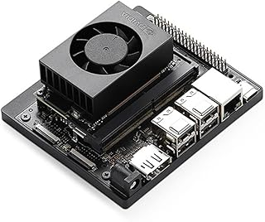
The RISE of Edge Computing
Explosion of Data & Devices: Billions of IoT devices are online, generating massive data at the “edge”
Why Edge AI Now:
Cloud computing can’t efficiently handle real-time needs. Latency, bandwidth, and privacy demands push intelligence closer to the edge
IoT device computing get more compute
Embedded systems SoC are growing fast
8-bit via 16-bit to 32-bit
From a few KBs to MBs of RAM
Small Edge / Strong IoT
Before: Small CPU-based Linux - RPi 1
Now: GPU capable devices Jetson Orin Nano
RISE ICE Edge Rack
Edge Compute (half-rack)
Small Edge

Slide 4
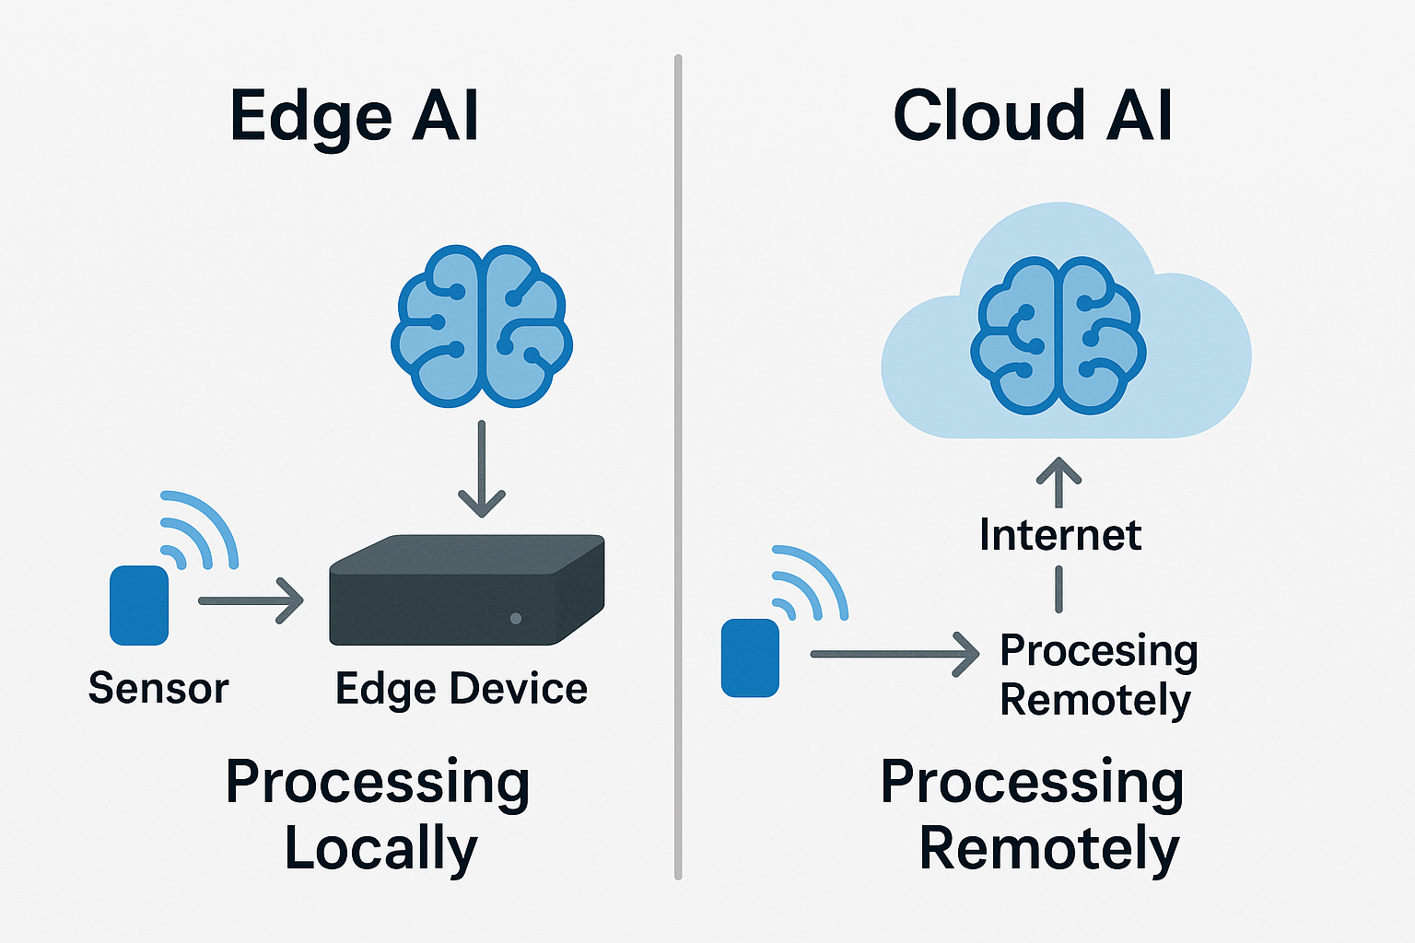

What is Edge AI?
Edge AI refers to running AI algorithms locally on edge devices (like sensors, smartphones, or embedded systems)
Data is processed on the device or nearby gateway as soon as it’s captured
Cloud is typically still used for resource-heavy training or central coordination
IoT
Gateway

Slide 5
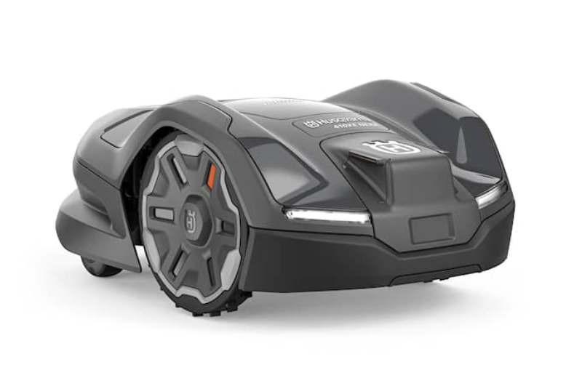
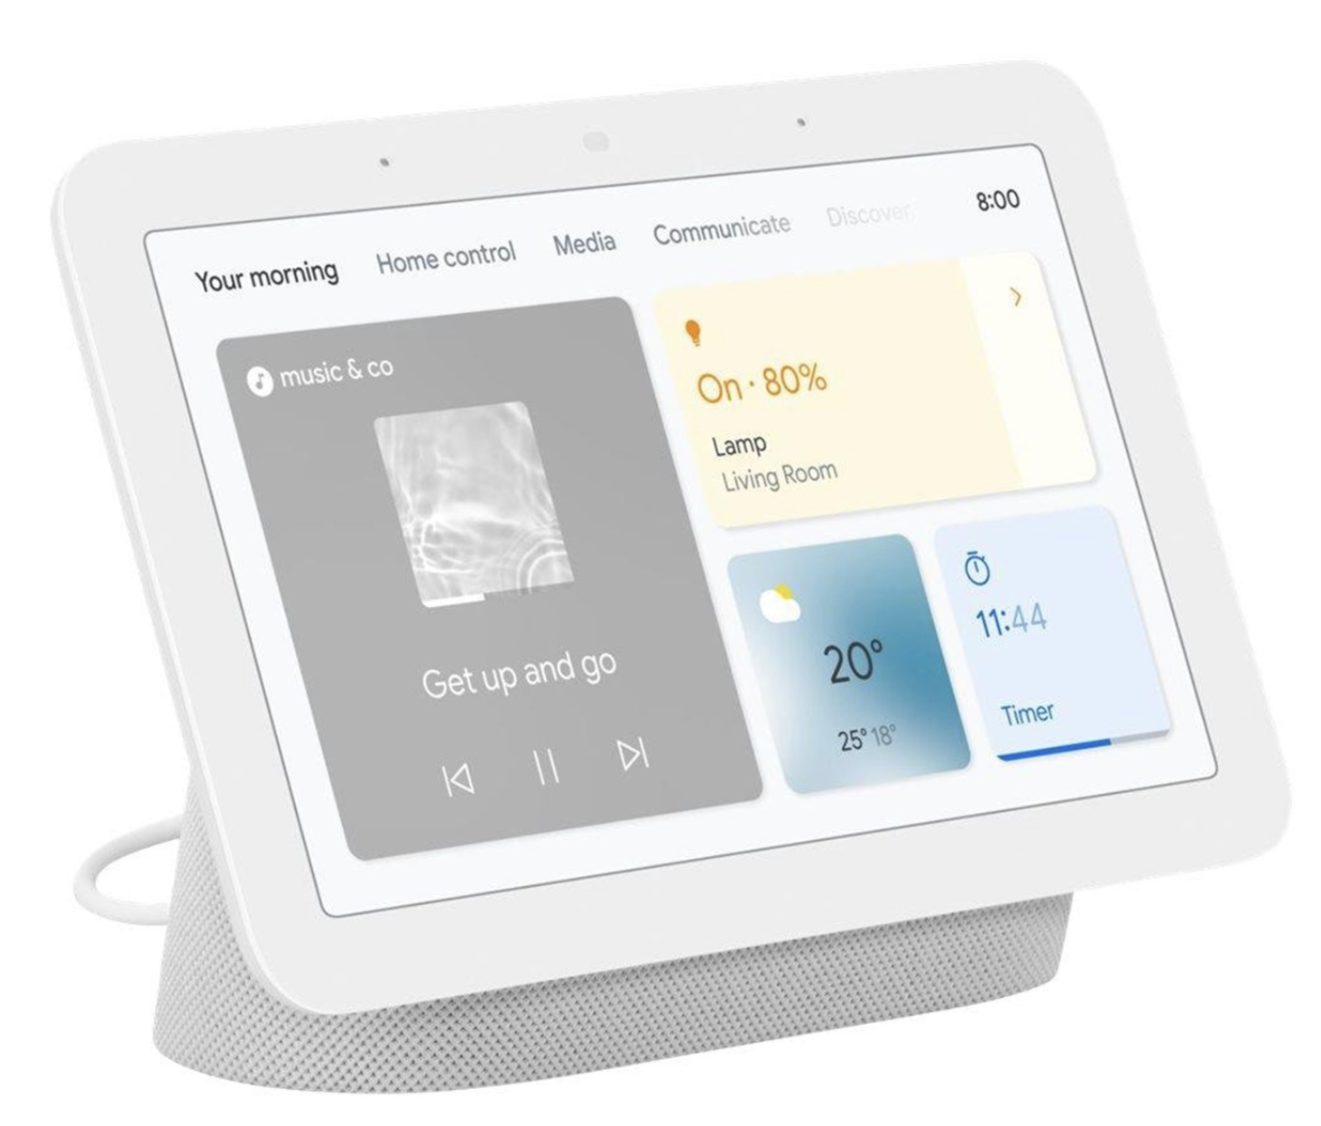
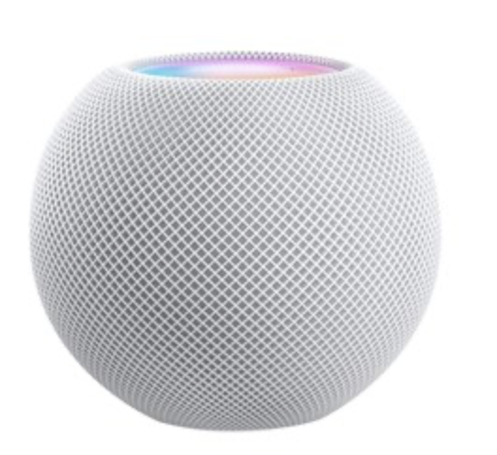
IoT Edge - AI For IoT / Physical Products
Local AI in physical products
Autonomous products (automowers)
Smart cameras (automatic object detection)
Smart wearables (sensors, etc)
Cloud AI in your phone
ChatGPT
Google Lens
Cloud AI in your home
Google Home, Apple Siri, Amazon Alexa

Slide 6
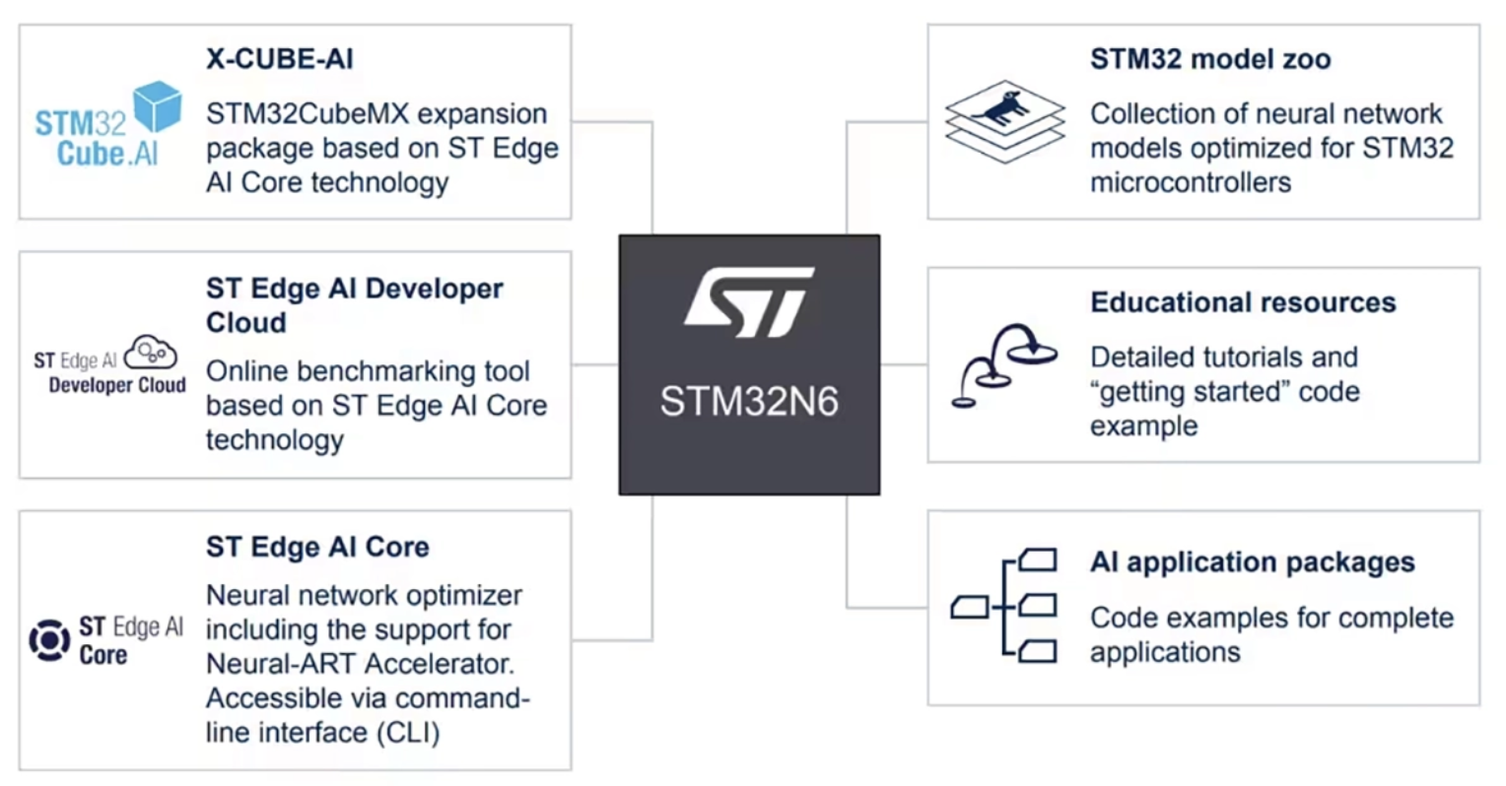
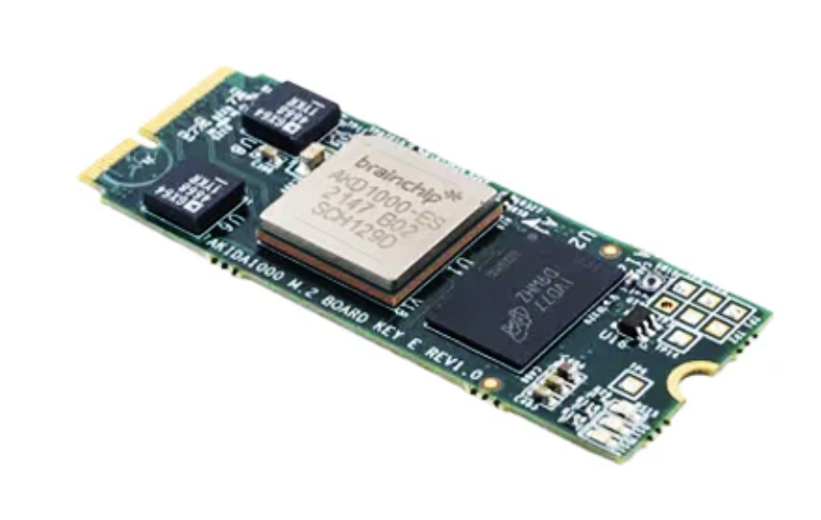
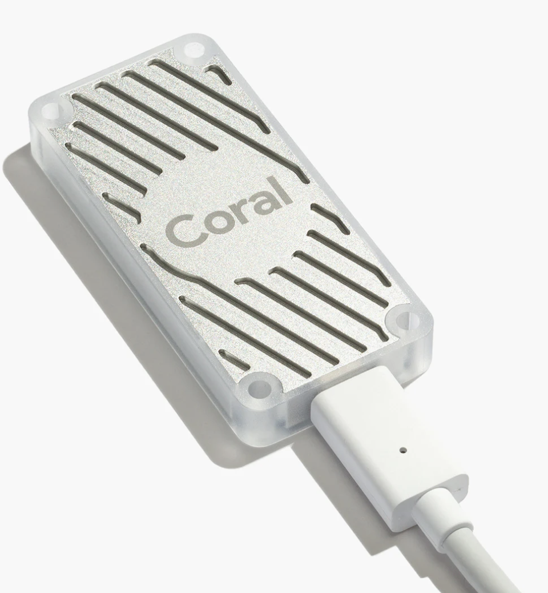
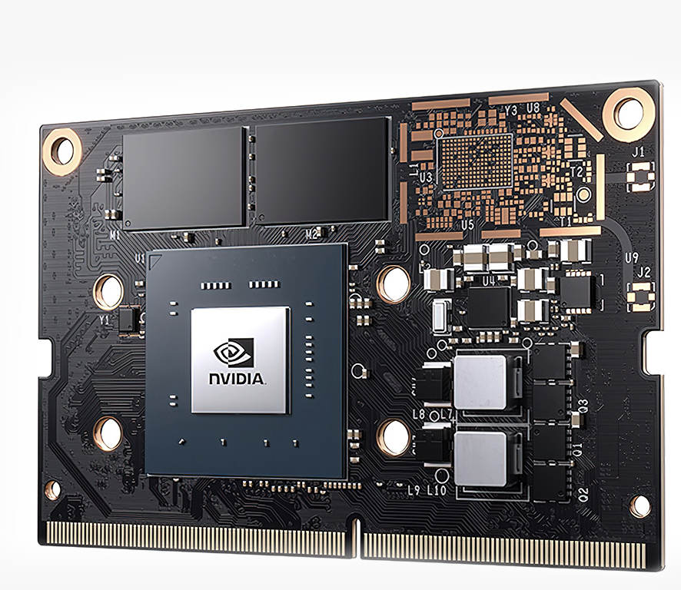
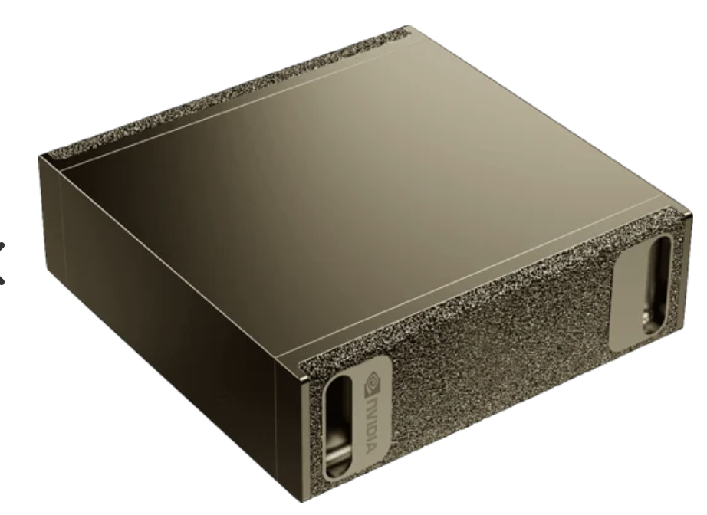
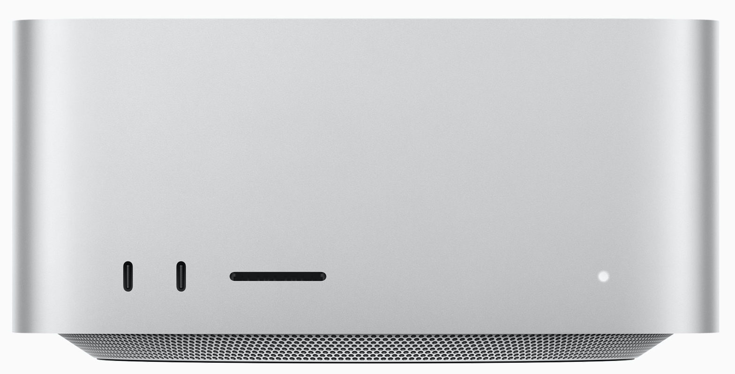
Edge AI – AI Accelerators
Specialized AI Chips: Modern edge devices increasingly include Neural Processing Units (NPUs), Tensor Processing Units (TPUs) or other AI accelerators
Benefit: Run complex models (e.g. image recognition, speech) within the power constraints of edge devices
Trend: Edge AI grows and even microcontrollers are getting tiny ML accelerators, and companies like NVIDIA, and Apple are heavily pushing edge-optimized AI hardware

Slide 7
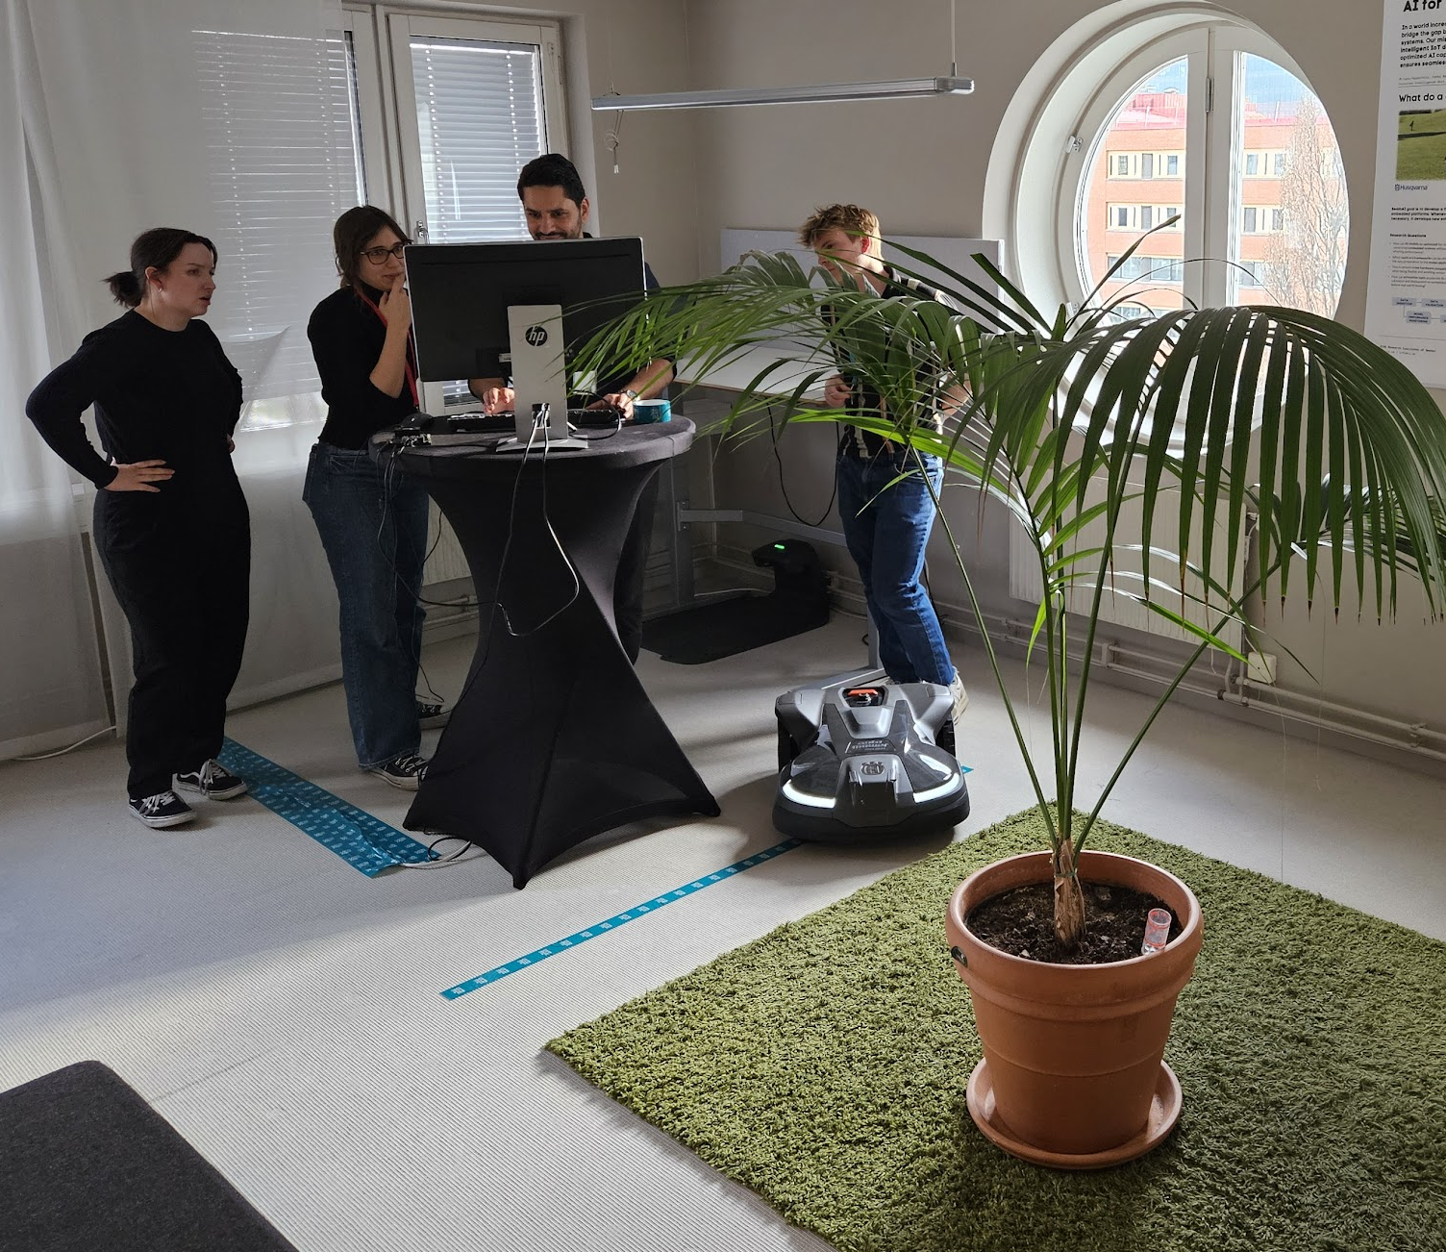

AI For Physical Products – Project: Seam AI
AI in physical products – in device ML, embedded AI
Partners:
RISE – innovation and project lead
Assa Abloy – Smart Doors
Husqvarna – Automowers
Antmicro – Open Source AI platforms
Project Focus:
Identify and develop an end-to-end open-source toolchain for implementing AI in products
Evaluate the toolchain in a set of proof-of-concept products
Demo of Seam AI & Automower - Seamless Integration of AI for IoT

Slide 8
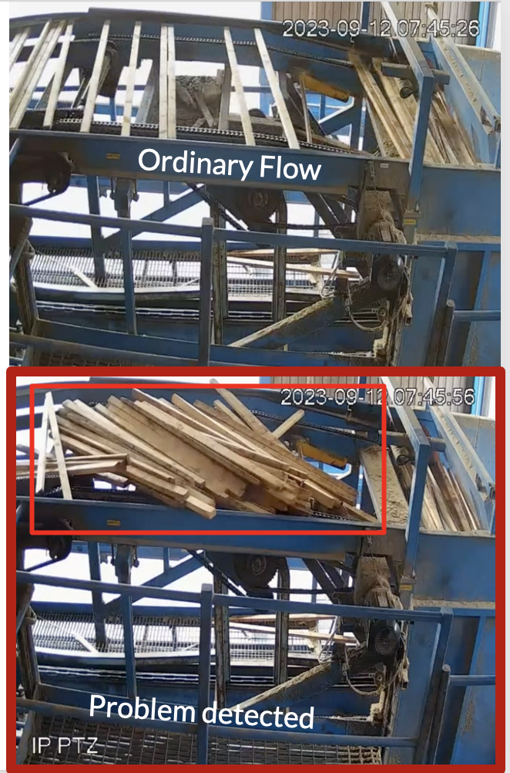
AI in Control – Edge AI Use-Case not in device, but local AI
Using AI for controlling production or physical environments
Use-case – avoiding stops in sawmill production
Detect problems very early
Act immediately to avoid longer stops
Running Local AI (slightly stronger edge / GPUs)
Complex rules and regulations around autonomous AI-based systems (safety, privacy, etc)
Khaled Abo – har byggt AI-modell på detta!

Slide 9
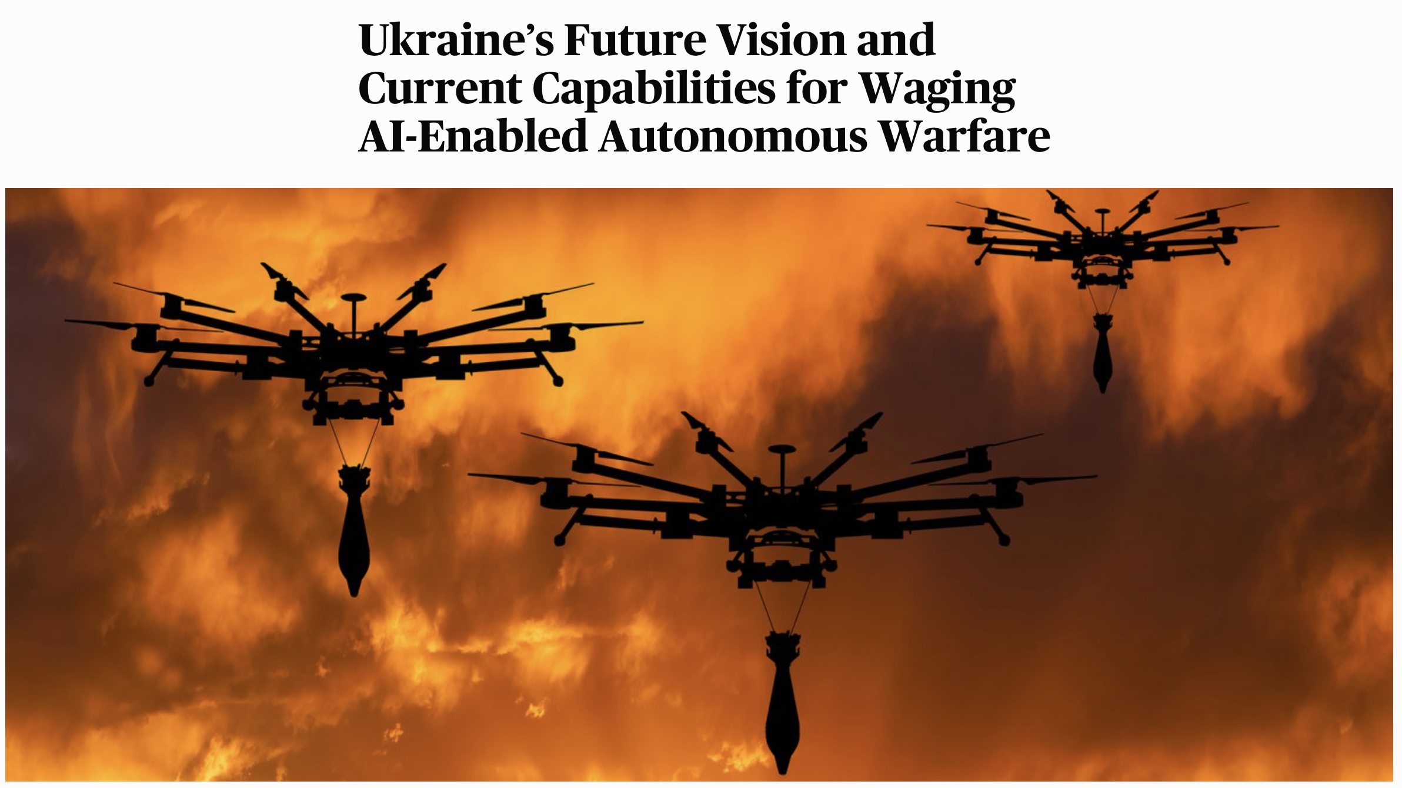
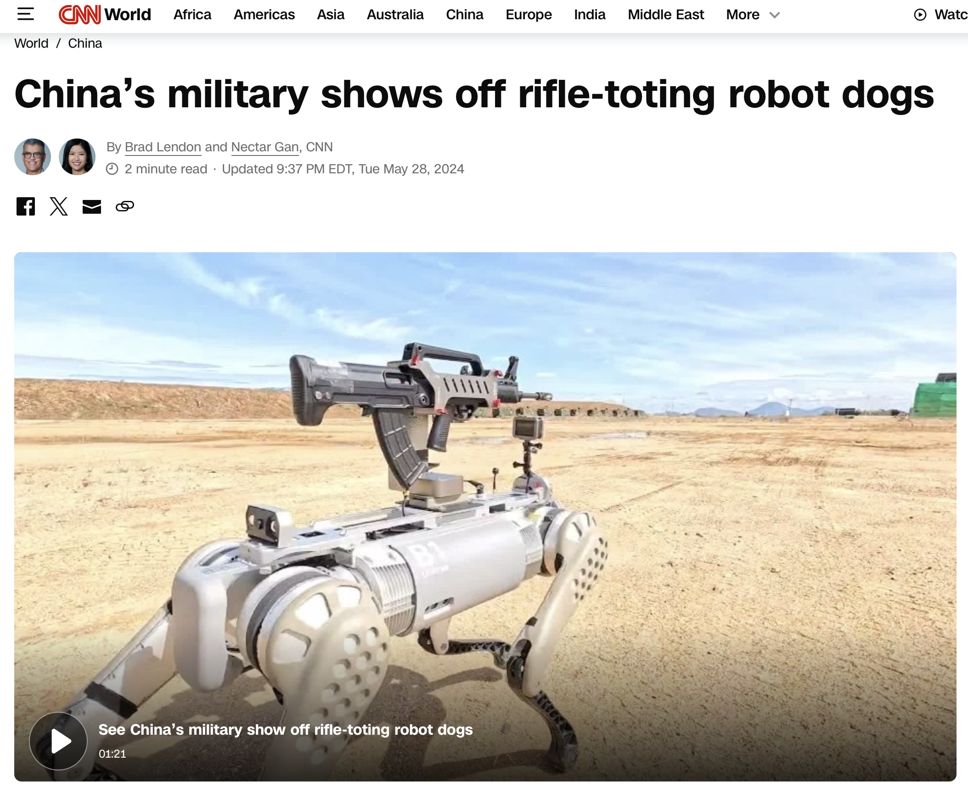
Other Edge AI Use Cases…

Slide 10
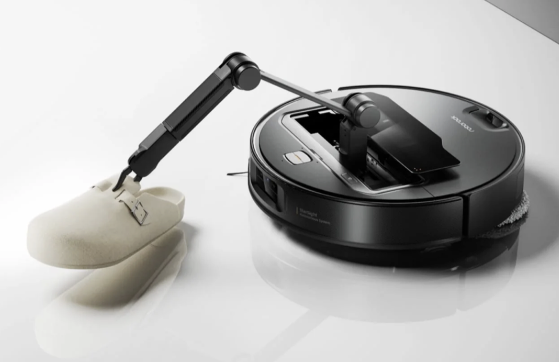
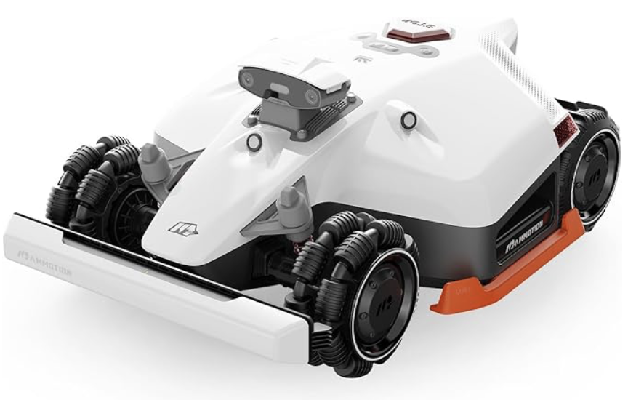
Why Edge AI for products?
Edge AI supports advanced control of physical/mechanical products
Autonomous even during disconnects
Edge AI and edge computing create more software-defined products that can be upgraded (Tesla and others with updates)
The product can adapt to its environment (by learning)
Competitiors adds it…

Slide 11
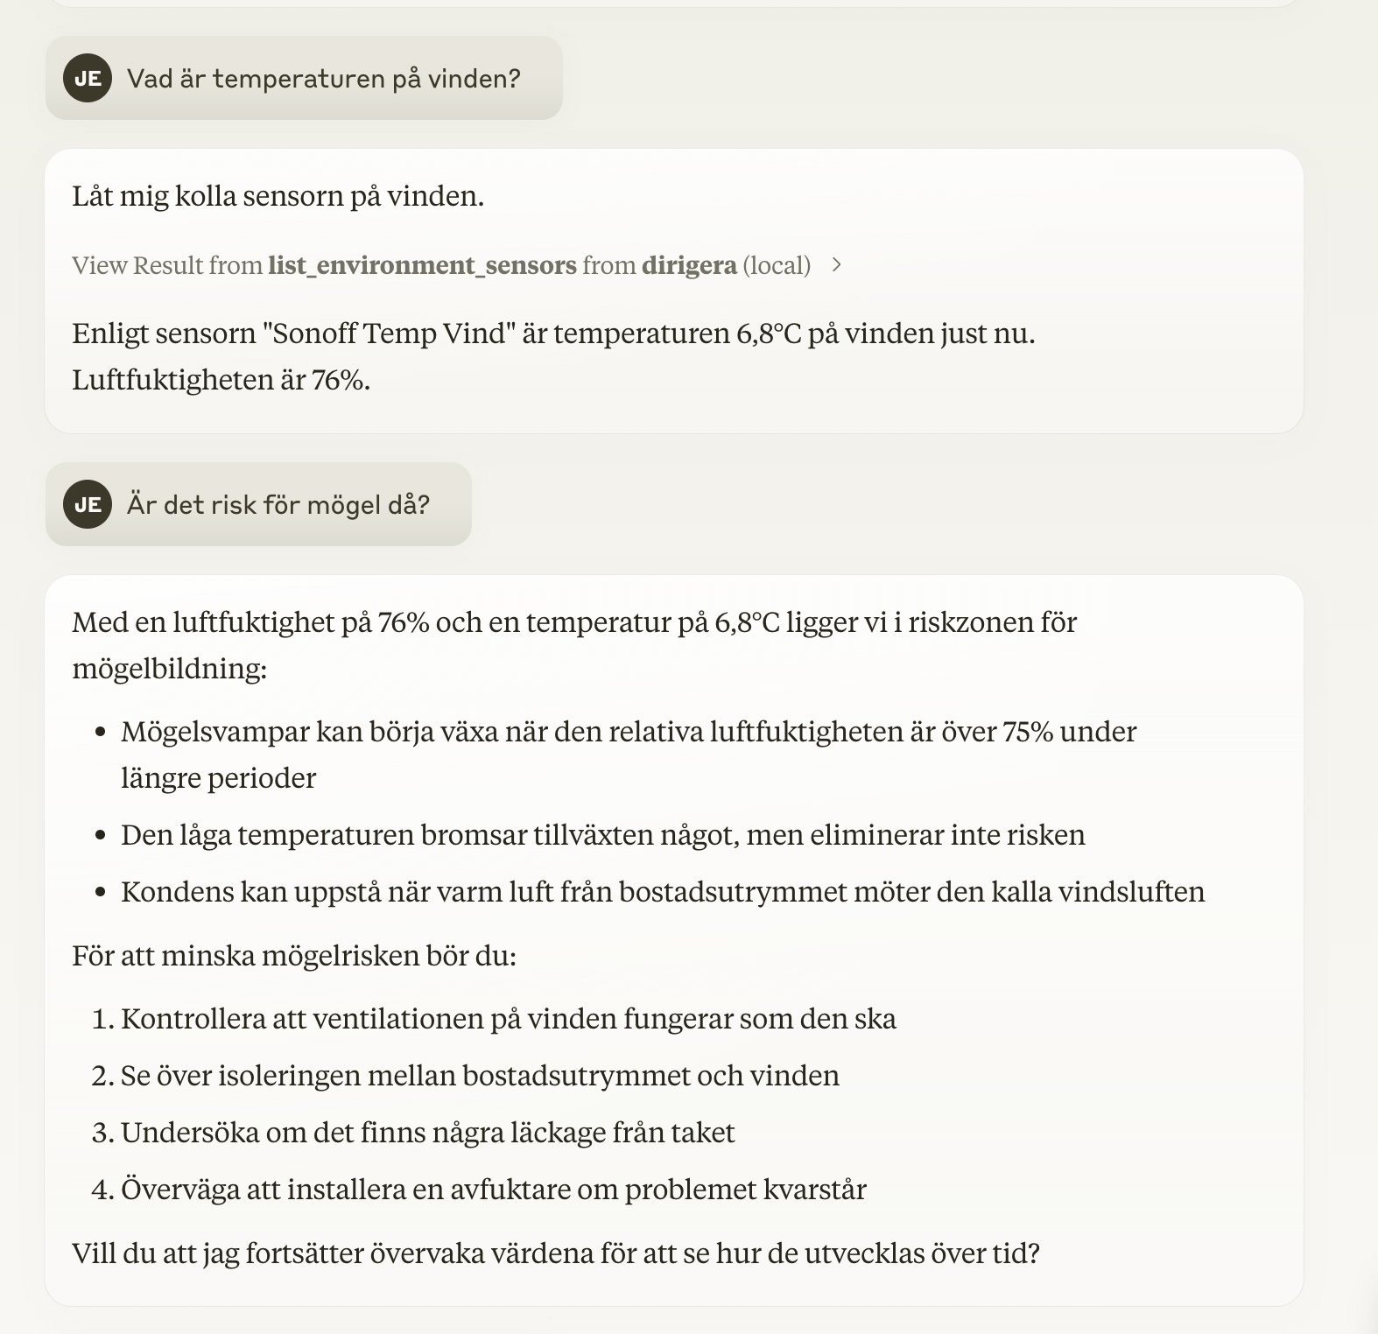
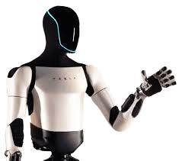
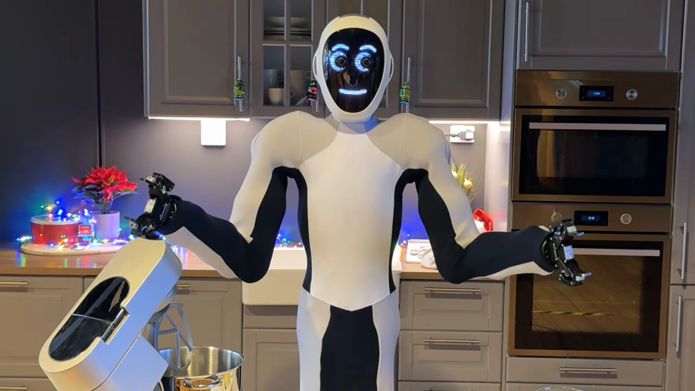
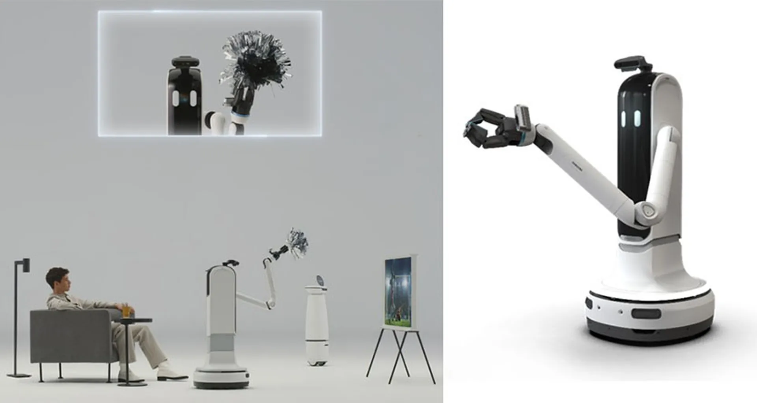
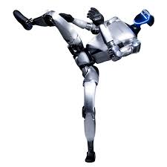
What is coming?
Humanoids, smart drones, LLM & IoT
AI in industry (AI in control / processes)
RISC-V – AI Accelerators for the Edge

Slide 12
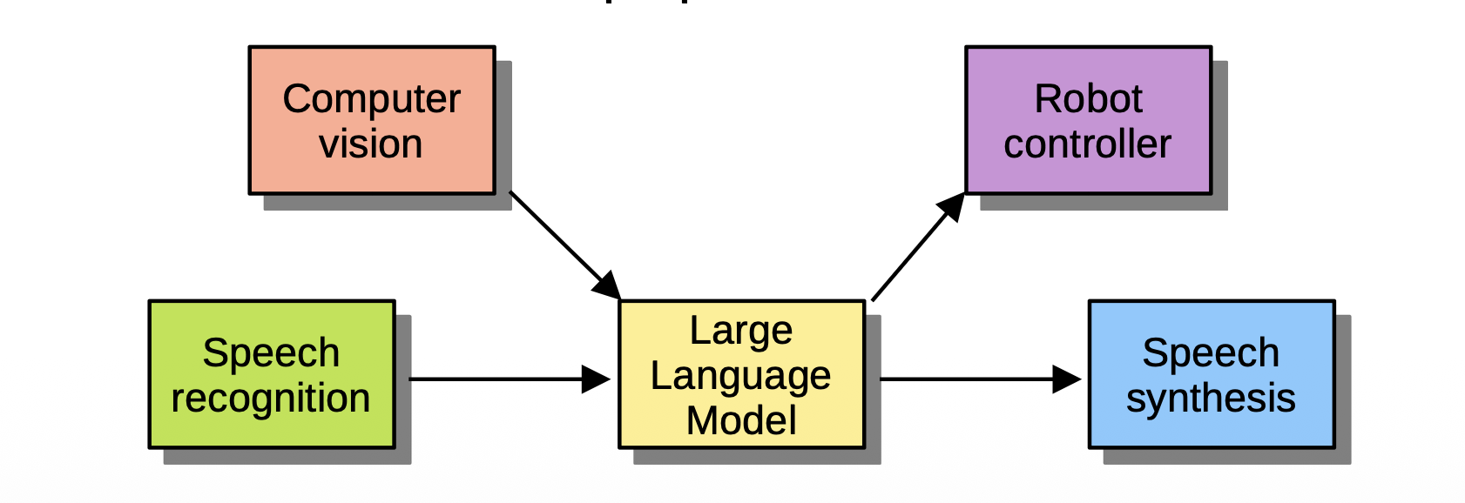
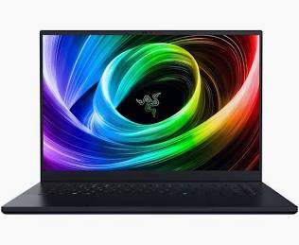
CandyTron 4000
Idea: Connect several AI models into a systems that solves some task, involving both human interaction, and has effects on the real world
Instantiation: A Candy Robot, equipped with a camera and a robot arm, which can manipulate candies on a table, and you can talk to it through a microphone and ask it for candy.
Only local models run on a laptop with a GPU.

Slide 13
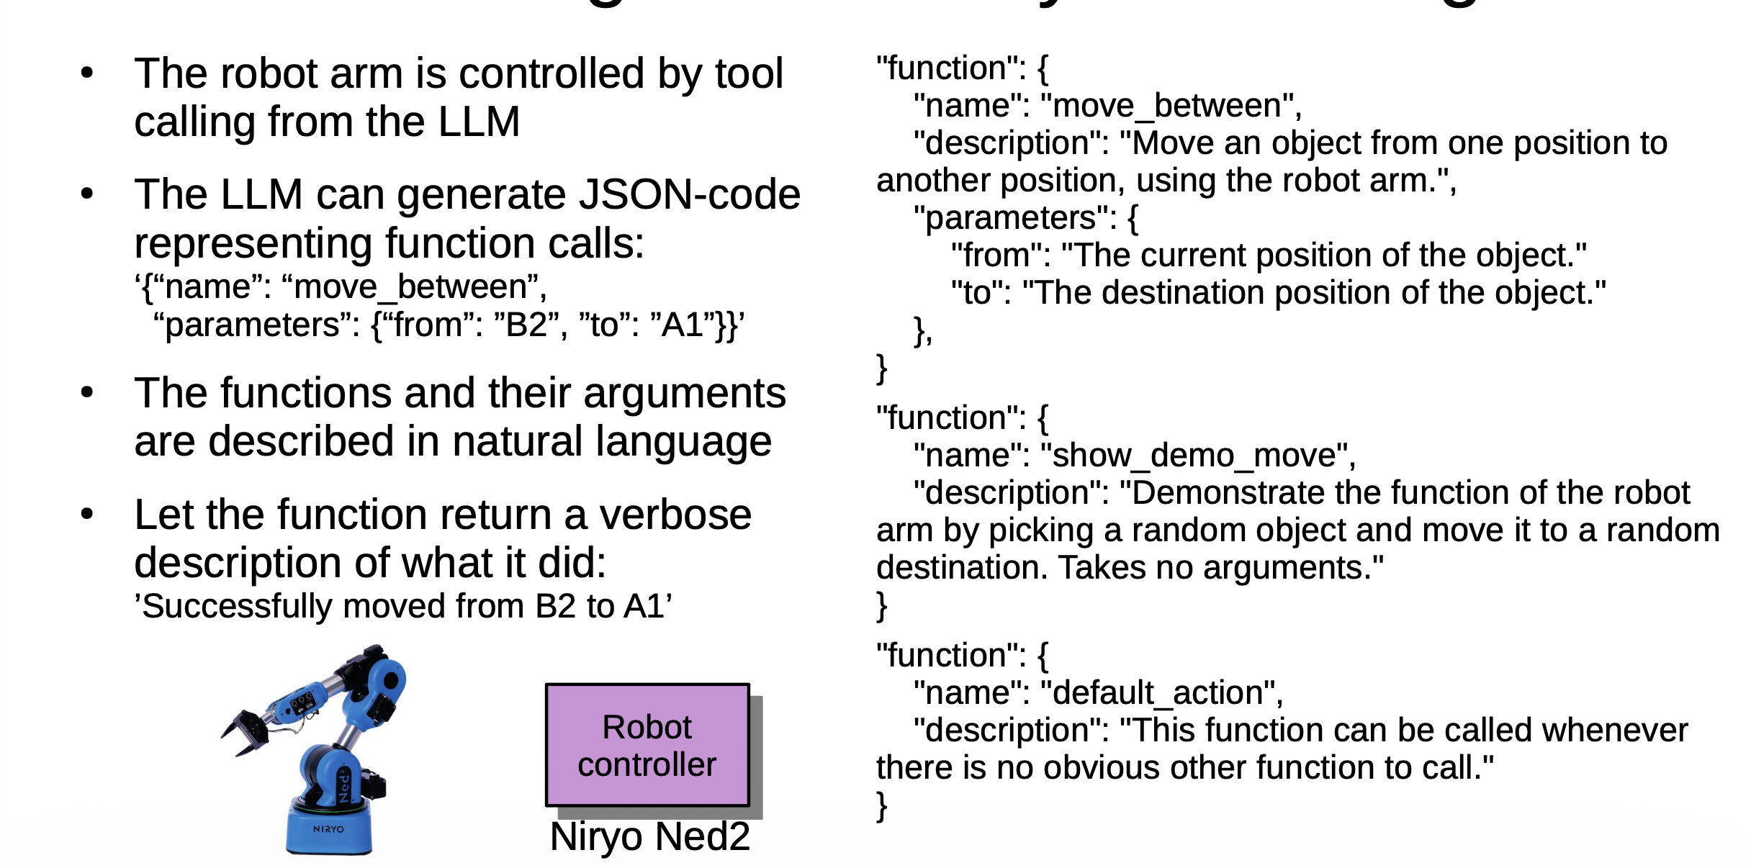
The ”Brain”: LLM with function calling / tool use

Slide 14
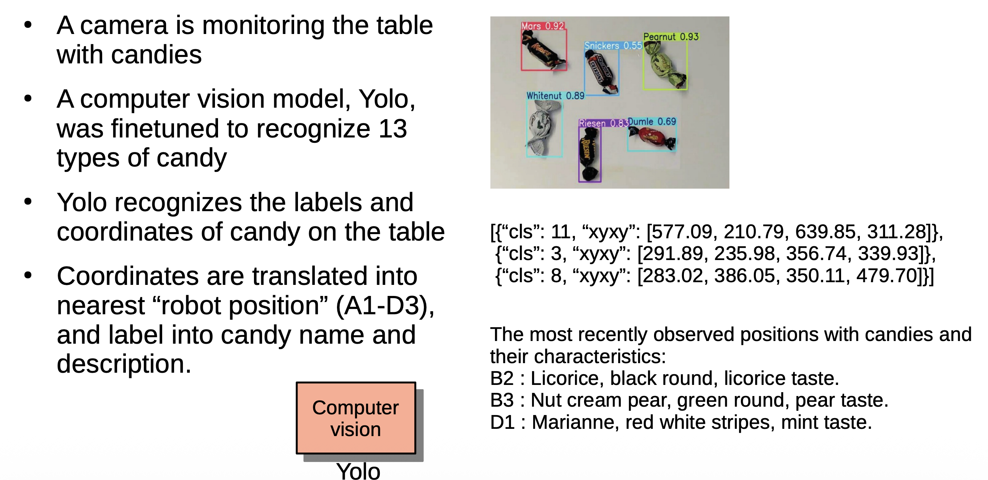
The Eyes – Computer Vision / Yolo 11

Slide 15

Ears and Mouth – Speech Pipeline

Slide 16

The Integration - Conversation example

Slide 17






Next Step: Vision-Language-Action Models
What is the next generation? CandyTron 4000
Vision-language-action?
Add vision as input to LLM
(sound also)
Add actions as output from LLM
Huggingface – Le Robot

Slide 18




Next Step – The Humanoid!
NEO – The soft-humanoid for your home (or office)
Inside NEO – NVIDIA - Thor

Slide 19



Gör din egen Candytron…
Gitrepo med nästa variant av Candytron (MCP)
https://github.com/joakimeriksson/mcp-agents
Gitrepo med nästa variant av Candytron (EU project)
https://github.com/cluster1-arrowcolony/candytron-demo

Slide 20

Thanks for Listening! Questions?
Joakim Eriksson, RISE joakim.eriksson@ri.se

